Slide 1
S.E.N.Y. – Professional Development Conference
Construction Safety 360
James Dickerson – Engineering Manager, DG-New York
March 19, 2019

Slide 2
Construction Safety 360
Agenda
  Barry-Wehmiller & Design Group Overview
  Project Profiles
  What does culture have to do with safety?
  Professional Empowerment
  Pre-Mobilization
  Project Safety Plan
  Inspection, Analysis, and Continuous Improvement
  Hazard Prevention and Control
  Training and Permitting
  Incident Reporting, RCA, Action Step Implementation

Slide 3

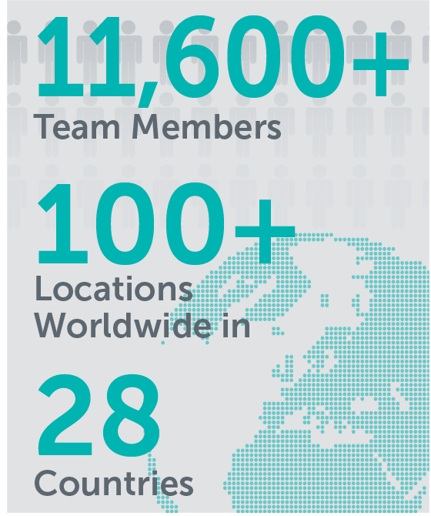


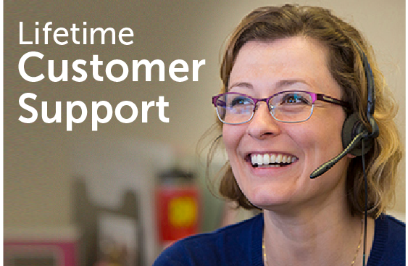





Barry-Wehmiller Companies

Slide 4
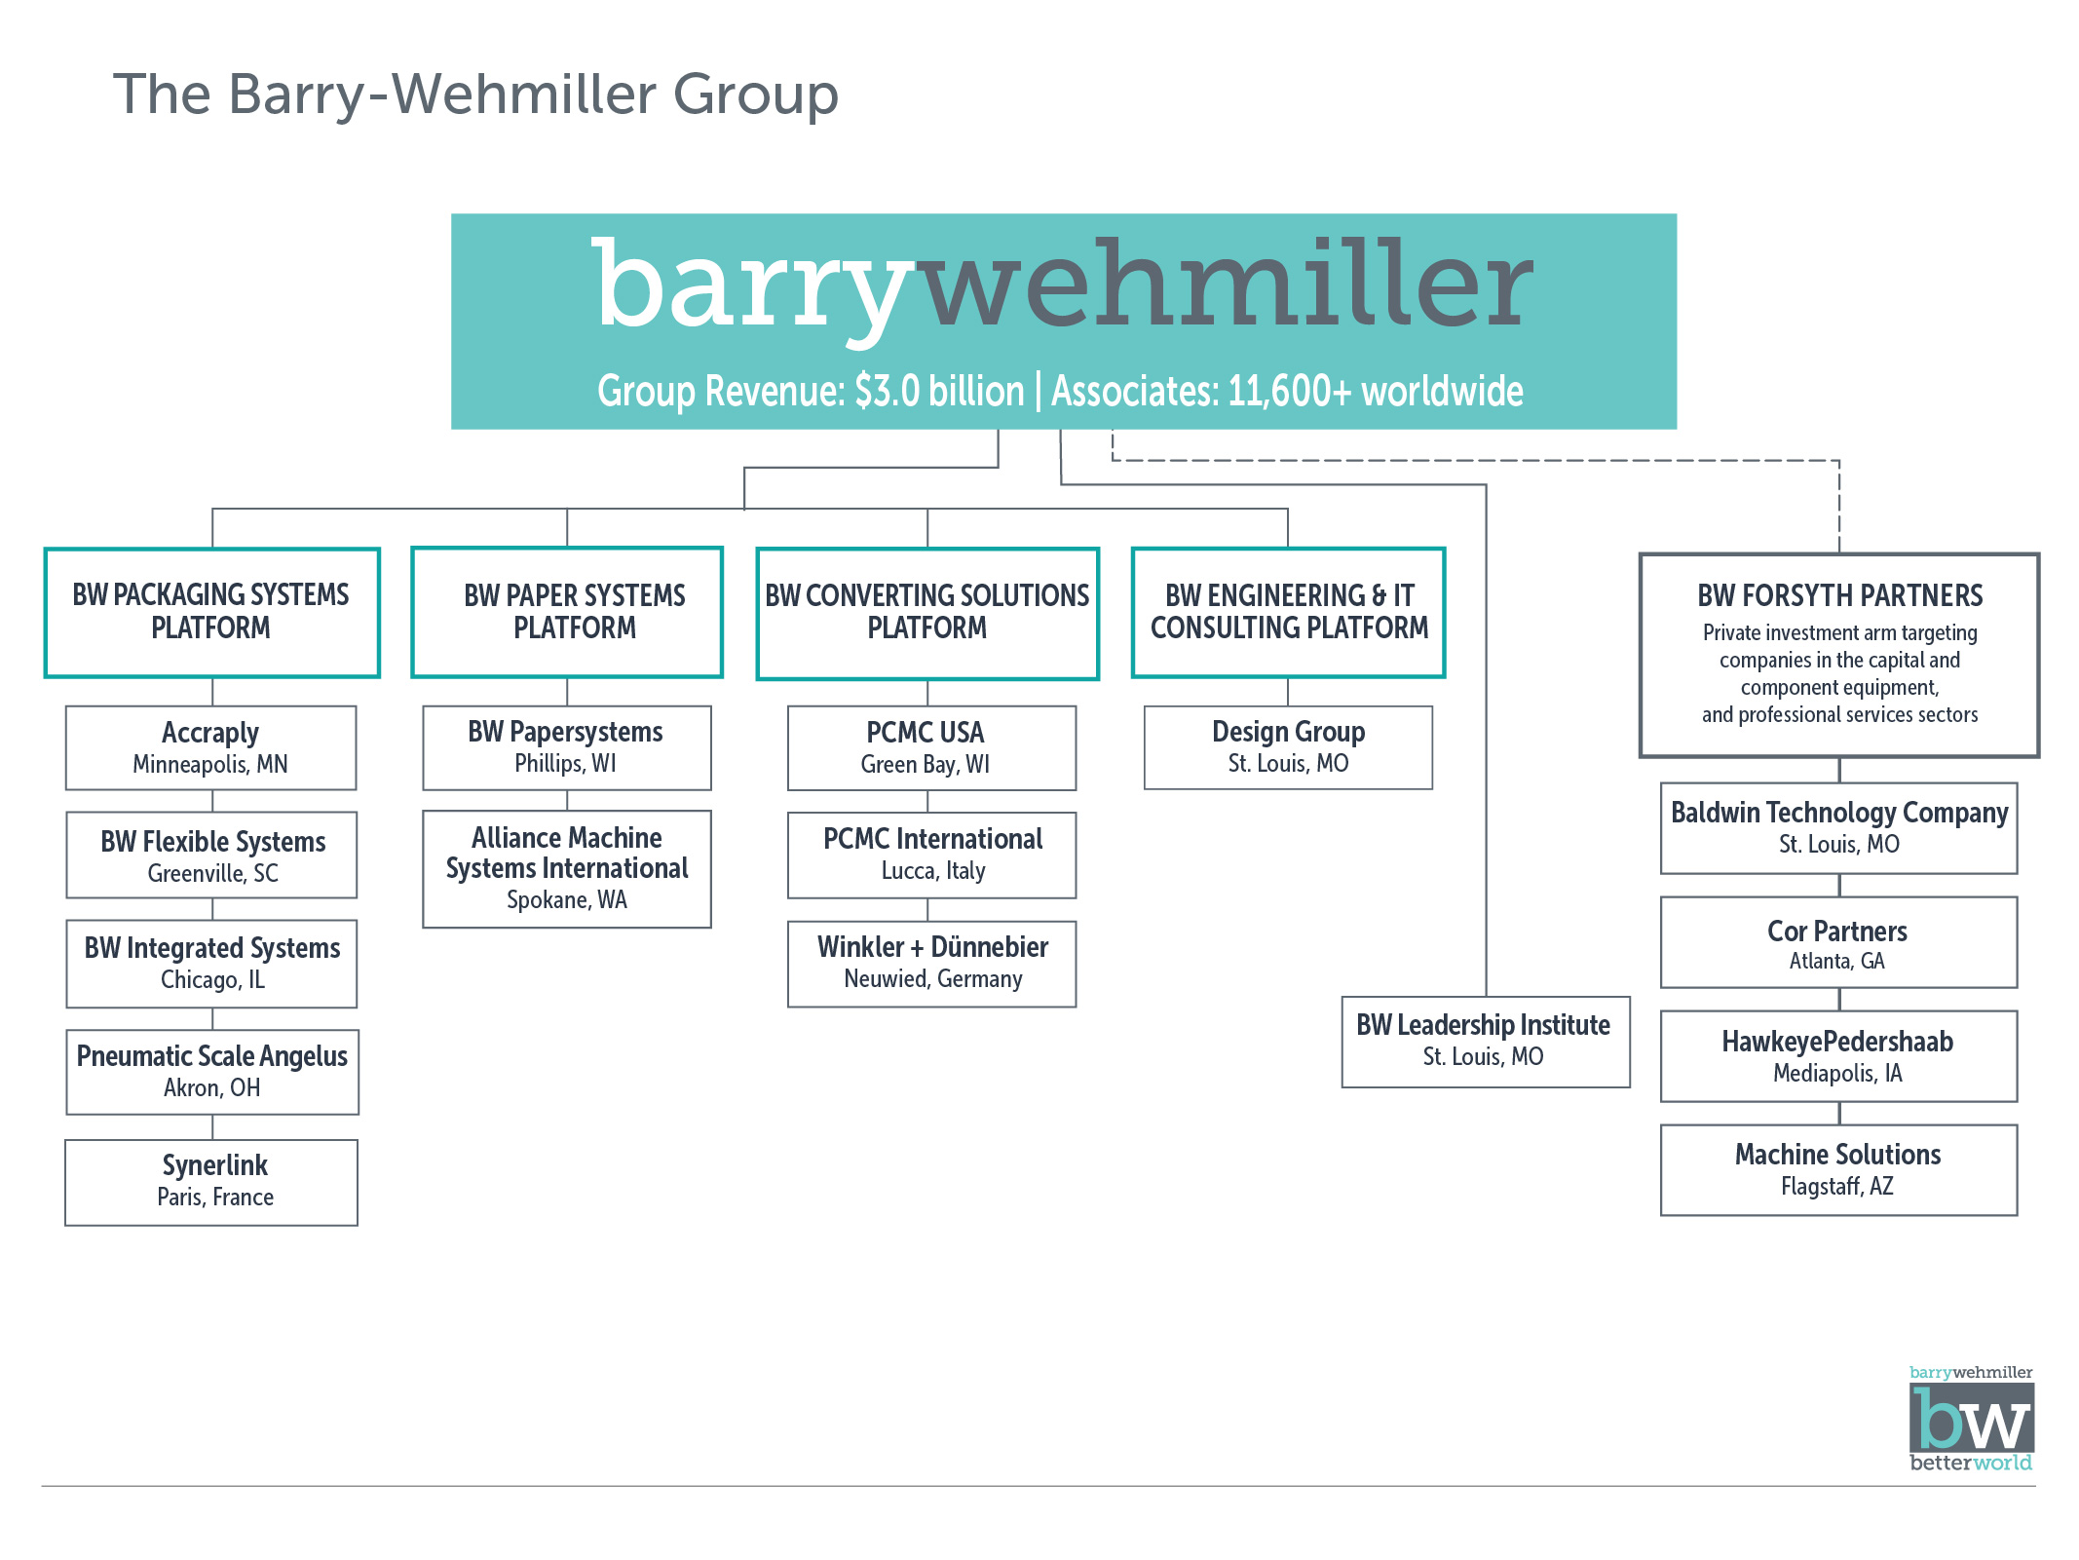
Barry-Wehmiller Group

Slide 5
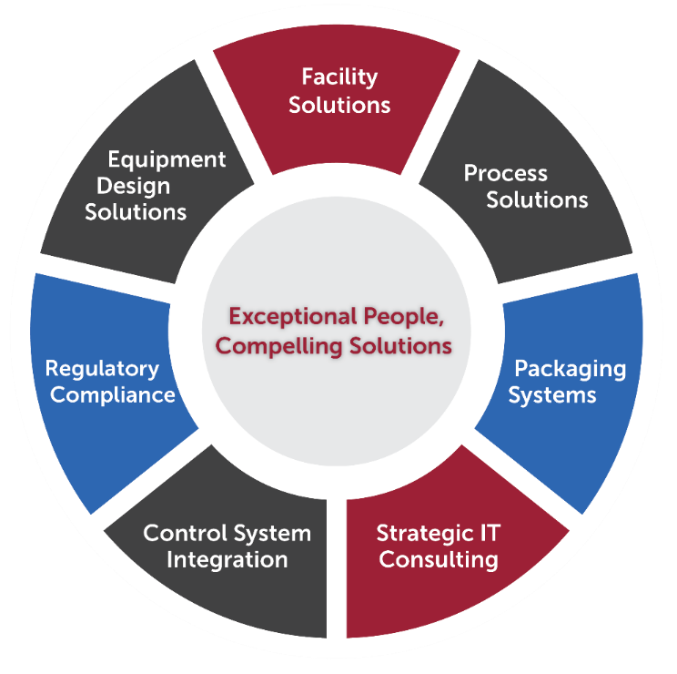
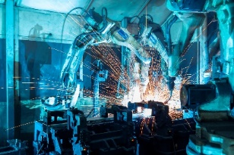
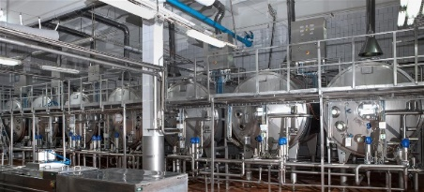
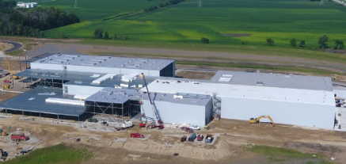
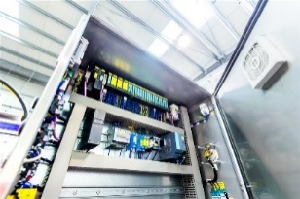
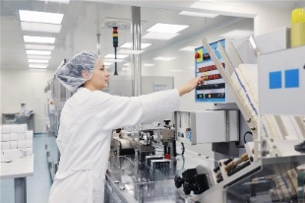
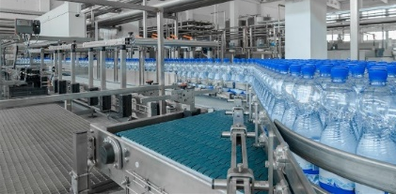
Who is Design Group?
A premier Engineering and IT consulting firm, providing a complete operating solution for consumer products, life sciences, and other industrial sectors.
We provide these services autonomous from the Barry-Wehmiller equipment companies
… as an independent Systems Integrator & Solutions Provider.

Slide 6
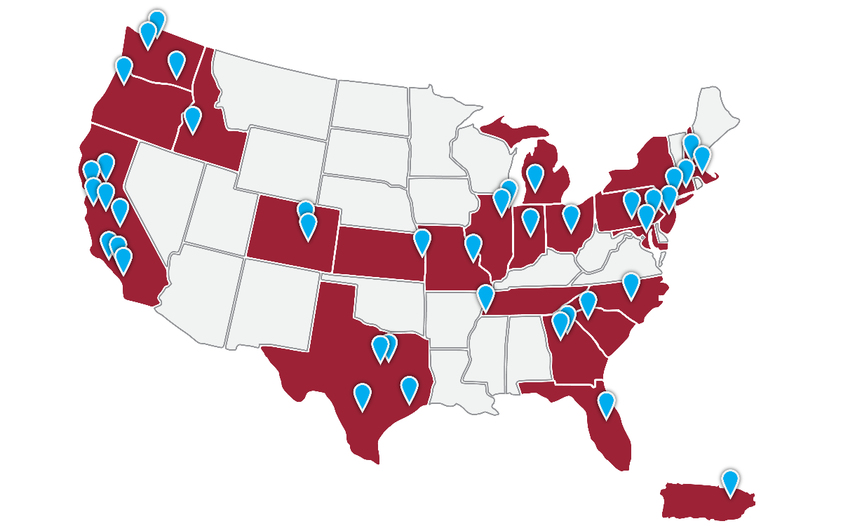
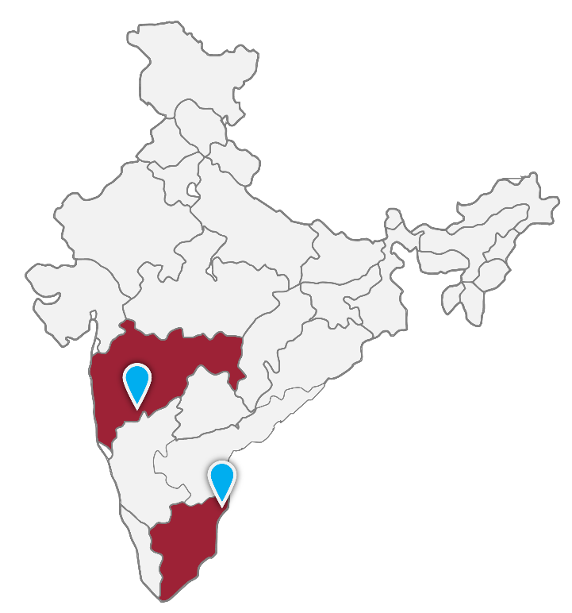
40+ Global Locations
Design Group operates from over 40 global offices in the US and India providing Engineering and IT consulting to the world’s leading companies through the efforts of over 1,400 engineering and technical specialists.
Design Group Offices

Slide 7
Industries Served
Home & Personal Care
Beverage
Dairy
Life Sciences
Shampoo
Conditioner
Body wash
Cosmetics
Lotions
Deodorant
Body Spray
Toothpaste
Bar & Liquid Soap
Detergents
Household Cleaners
Aerosols
Air Fresheners
Cat Litter
Pet Food
Carbonated Soft Drinks
Beer / Wine /Distilled Spirits
Bottled Water
Extended Shelf Life
Aseptic
Hot Fill Beverages
Juice
Cheese, Cheese Block Cutting, and Packaging
Yogurt Products
Ice cream and Novelties
Fluid, Cultured, and Flavored Milk Products
Aseptic and Extended Shelf Life (ESL) Processing
Pasteurization
Separation & Homogenization
Whey Processing and Drying
Tablet Bottling Lines
Blister Lines
Liquids Filling and Packaging
Creams and Ointments Packaging
Vial and Syringe Lines
Aseptic Filling and Packaging
Finished Goods Conveyance
Central Palletizing
Labeling and Inspection
Serialization, RFID
Packaging Hall Consolidation & Reconfiguration
Package Development
Regulatory Services
Food
Snack Foods
Baked Goods & Pastry
Ingredients & Powders
Coffee & Tea
Chocolate & Confections
Soups, Sauces, Dressings
Vegetable Processing
Jelly & Jam
Beef & Pork Harvesting & Further Processing
USDA Regulated Facilities
Light Industrial
Lubricants
Bulk Materials
Light Chemicals
Plastics

Slide 8
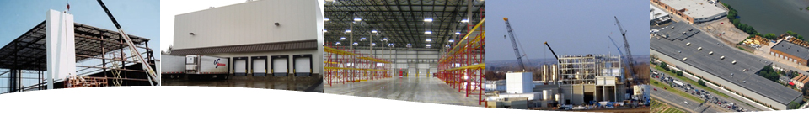
Construction Management Services
Conceptual Design
Final Design
Project Management
Preconstruction
  Cost Forecast Estimates
  Cash Flow Estimates
  Project Schedule
  Safety Plan Development
  Quality Assurance Plan
  Construction Phasing Plan to Maintain Plant Operations
  Bid to Local & National Subcontractors
  Labor Management
  Site Work Plan Development
Construction Phase
  On-Site Supervision &
  Field Engineering
  Open-Book Bids and Contracts
  Implement & Manage Project Safety Program
  Manage Project Schedule
  Change Management
  Quality Assurance Management
  Manage Payments & Lien Waivers
  Monthly Cost Forecasts & Control Reports
Project Closeout
  Punch List Administration
  Final Project Accounting
  Commissioning
  Final Procedures & Manuals
  Systems Startup & Training

Slide 9
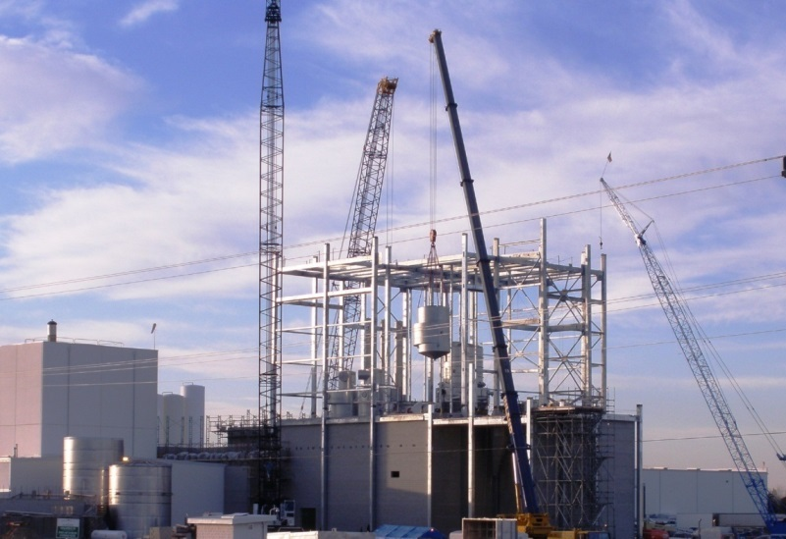
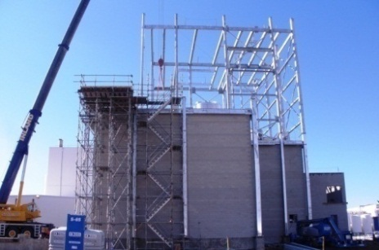
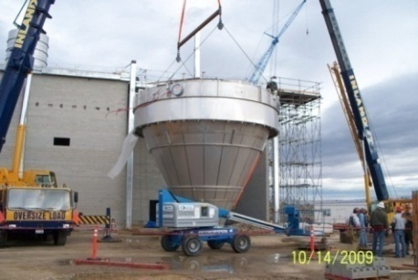
Dairy – Facility & Utility
New Whey Drying Facility & Process for Existing Cheese Manufacturing Facility
Project Scope:
  $28MM Overall Project Budget
  Facility & Utility - $18MM
Scope of Supply:
  Master Planning Services
  Overall Project Management
  Procurement & Supplier Management
  Facility Design & Construction
  Permitting
  Utility Design & Installation
  Construction / Startup Management
Notable:
  On-Schedule
  Less Than 3% Budget Variance From Initial Plan
  Compressed Schedule
  Zero Loss Time Accidents

Slide 10
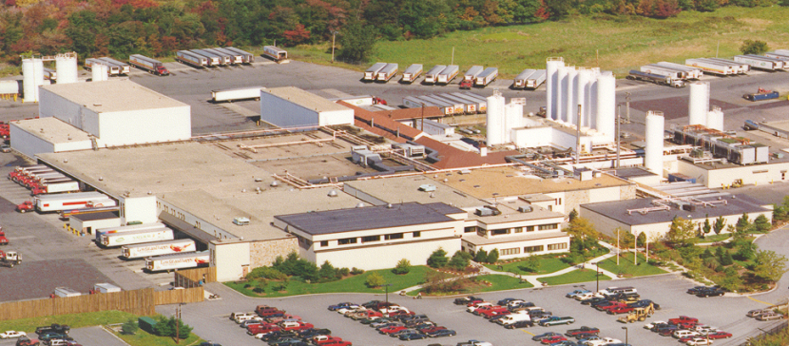
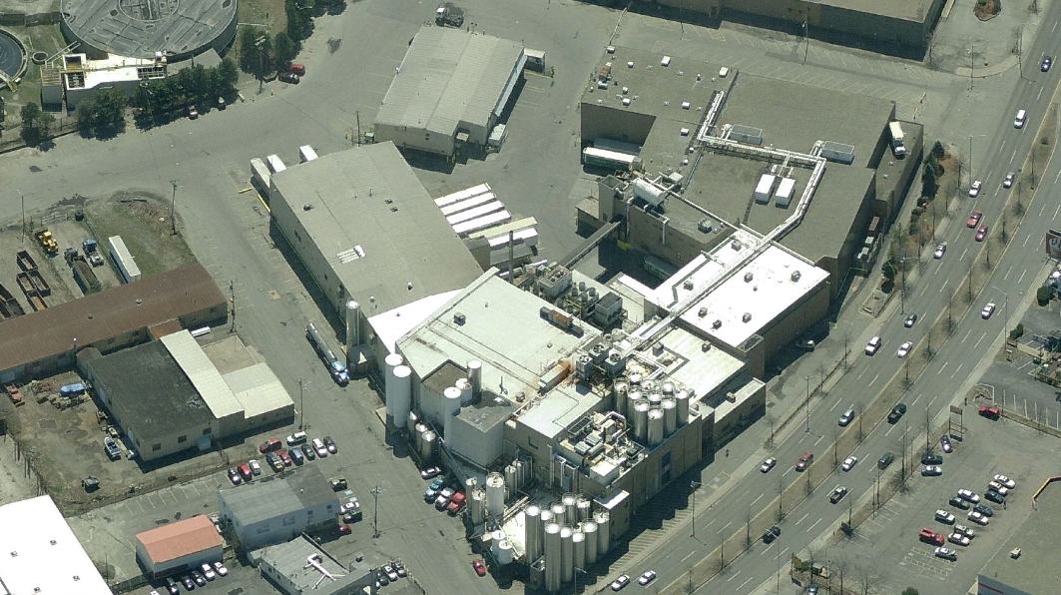
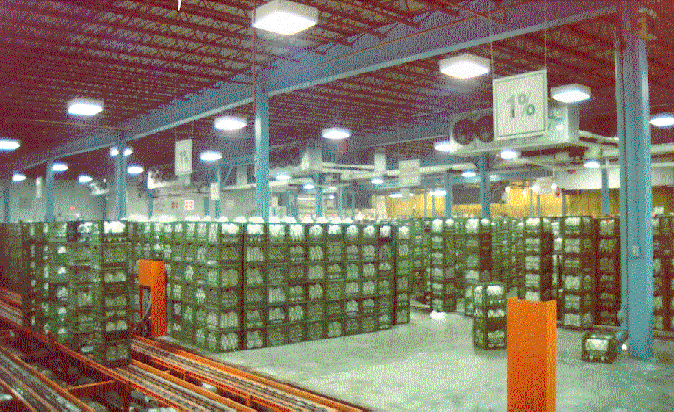
Dairy (Fluid Milk)– Facility Design Services
Scope:
  Over 100 projects at multiple facilities since 1985
  Engineering Studies, Master Planning, Design and Construction Management Services for coolers, freezers, boiler room, waste treatment, refrigeration systems, production line improvements and cream buildings.
  Facility Planning, Engineering, Construction Management

Slide 11
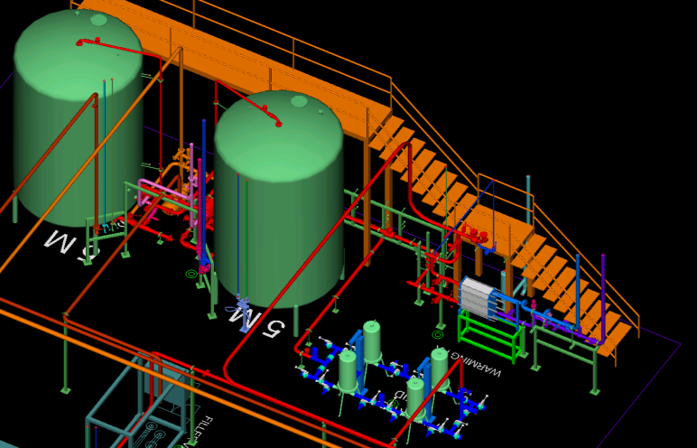
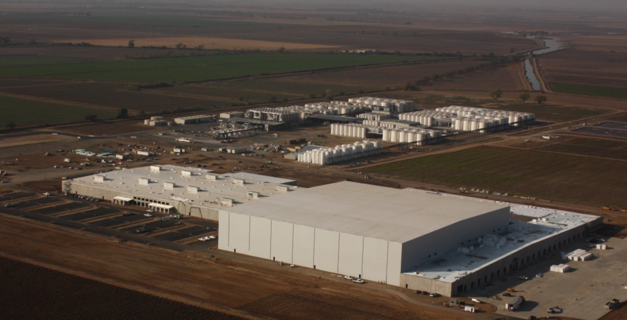
Wine – Total Operational Solution
Greenfield Wine Production Facility
Project Scope:
  New 660,000 ft² Facility
    260,000 ft² Bottling Hall
    400,000 ft² Warehouse & Distribution Facilities
  4 Bottling Lines
  4 Process Systems from Bottling Cellar to Fillers
Design Group Scope of Work:
  Project Management
  Packaging System Design & Automation
  Process System Design & Automation
  Facility Design (Civil, Structural, Architectural)
  Utility System Design
  Construction Management
  Start-up Support & Training
  Approach:
  Stage Gate
  Design – Bid (Owner-held contracts)

Slide 12
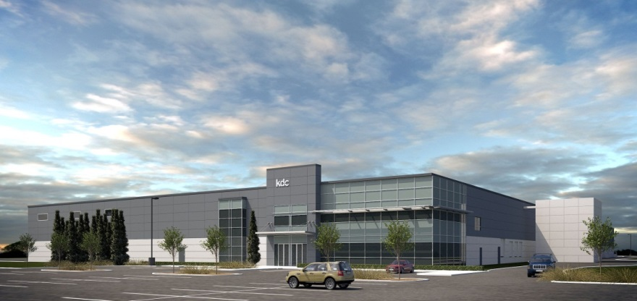
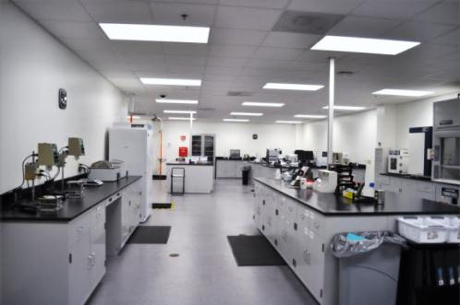
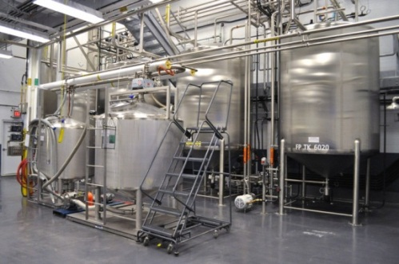
Personal Care – Total Operational Solution
New Manufacturing Facility Including All Processing & Packaging Systems
Project Scope:
  New Greenfield Facility
  Designed for (4) Packaging Lines
  Soaps, foaming soaps, fragrance splash
  Multiple batching suites
  Interior & exterior bulk tank storage
  100,000 sq. ft. Warehouse
  75,000 sq. ft. Packaging Hall
  55,000 sq. ft. Process, QC, Admin
  Scalable and Expandable
Design Group Scope of Supply:
  Initial Master Planning Study
  Site Plan & Permitting
  Full Design & Build Responsibility
  Material & Equipment Procurement
  Contractor Selection & Management
  Packaging & Process System Design & Implementation

Slide 13
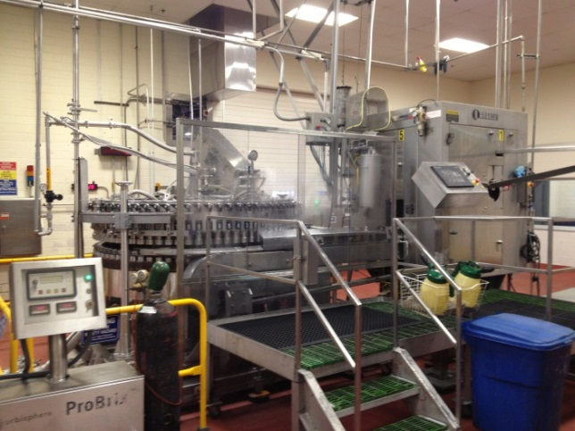
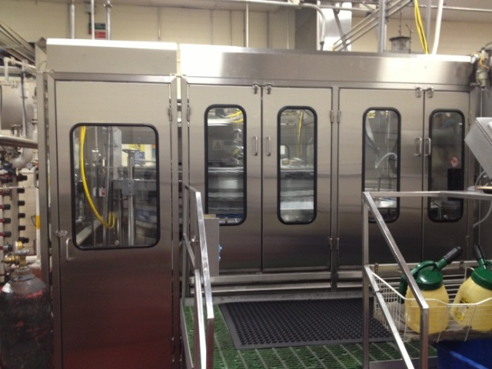
Beverage – Safety Systems
Safety Guarding Upgrades - (33) Existing Fillers at (15) sites
Project Scope:
  Electrical Safety System
  Mechanical Guarding Package
  Automatic Level Control
  Automatic Product Sampling System
  System Validation
  Equipment Start-up
  Design Group Scope of Work:
  Program Management
  Financial Administration and Purchasing
  Mechanical and Electrical Design
  Construction Management
  Start-up Management
Before
After

Slide 14
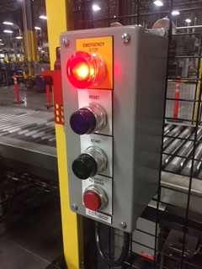
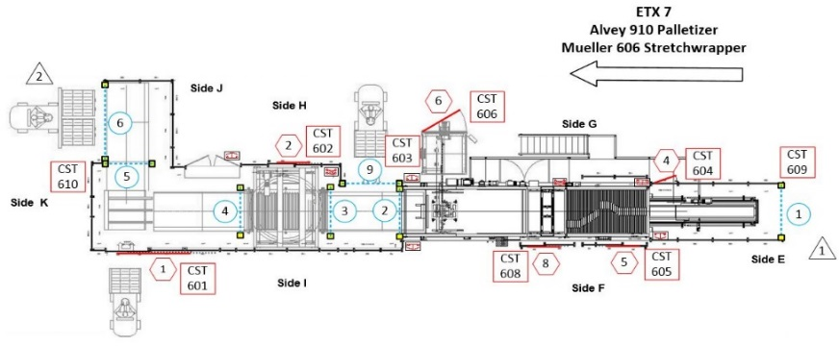
Project Profile: Palletizer and Stretchwrapper Safety Guarding
Design, installation, validation and commissioning of a multi-zone palletizer and stretch wrapper safety system for 10 beverage lines
Design Group Scope of Work:
Turn key safety system for end of line machines
  Palletizer, stretch wrapper, pallet conveyor
Safety assessment completed by Rockwell Automation
Mechanical guarding design
Electrical panel design and procurement
Control system design and integration for 7-zone safety system
Installation contractor management
Static and functional validation with Rockwell Automation
System start up support

Slide 15

Good Culture Starts with Leadership
“Everyone wants to do better. Trust them. Leaders are everywhere. Find them. People achieve good things, big and small, every day. Celebrate them. Some people wish things were different. Listen to them. Everybody matters. Show them.”
– from Everybody Matters: The Extraordinary
Power of Caring for Your People Like Family
everybodymattersbook.com

Slide 16
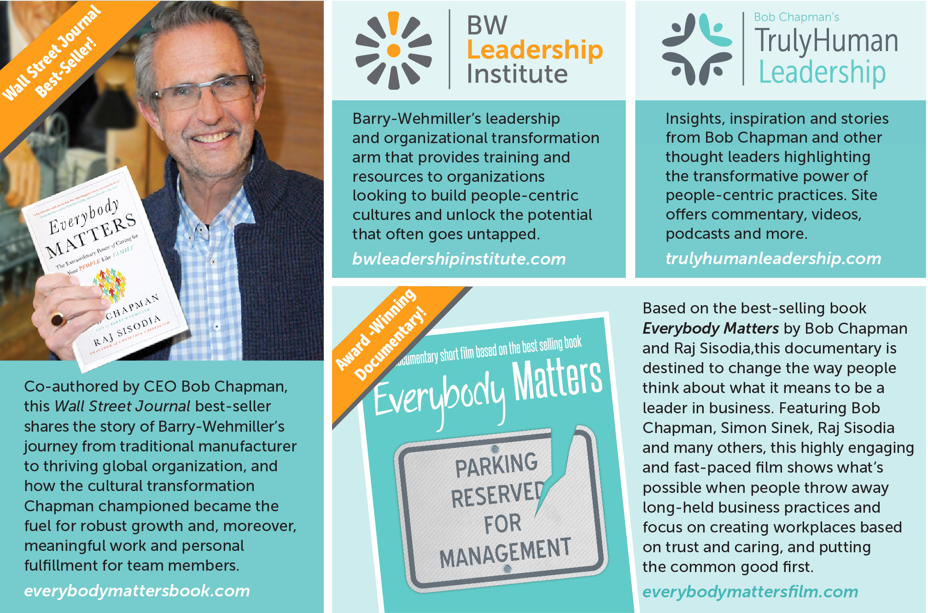
A Good Culture is a Safe Culture

Slide 17
But Why?
When are we most likely to get injured at work?
  When we are generally feeling fulfilled, happy, supported and respected by our peers?
  or
  When we are feeling stressed, frustrated, overwhelmed, or alone?
If I trust my manager, I am more likely to feel that they will listen if I raise a concern about workplace safety.
If I feel empowered to make decisions, I am more likely to take a pause to ask questions about the safest way to complete a task
  If I don’t know the proper way that a task should be done, but I know that my supervisors support and respect me and are always there to help, I will feel empowered to ask for help.

Slide 18

Bob Chapman on The Safety Covenant

Slide 19
Safety Culture and Responsibilities
Safety Covenant: Barry-Wehmiller Companies objective is to send every life we touch home healthy, safe and fulfilled each day.
Safety Vision: Barry-Wehmiller Design Group, is committed to creating & living a culture where safety is recognized as a company value & ensures every life we touch goes home healthy, safe, & fulfilled.

Slide 20
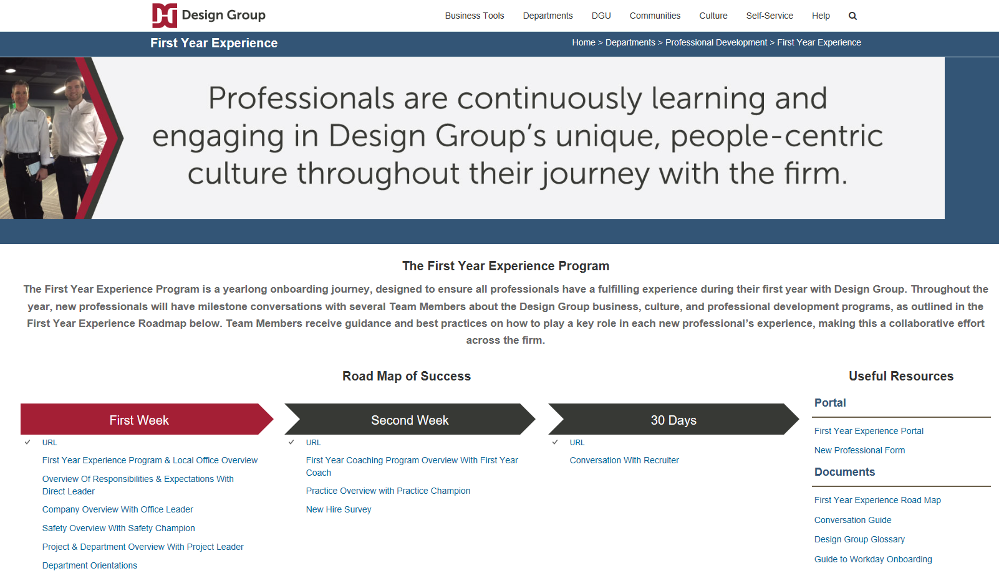
‘First Year Experience’

Slide 21
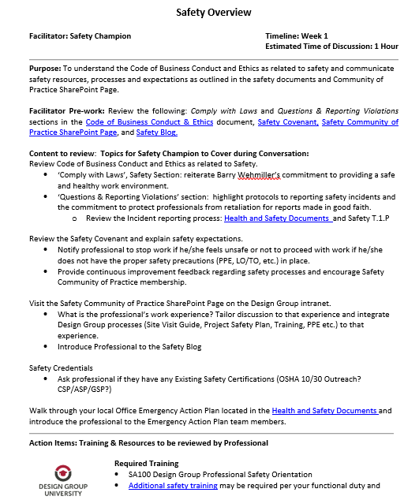
Safety Program Overview
During the First Year Experience Program, a senior safety leader, such as the local Office Safety Champion guides the new professional through all of the resources that are available to them, including:
  PPE Procurement
  Role-specific safety training
  Project Safety Plans
  Activity Hazard Analysis / JSA
  Incident Reporting

Slide 22
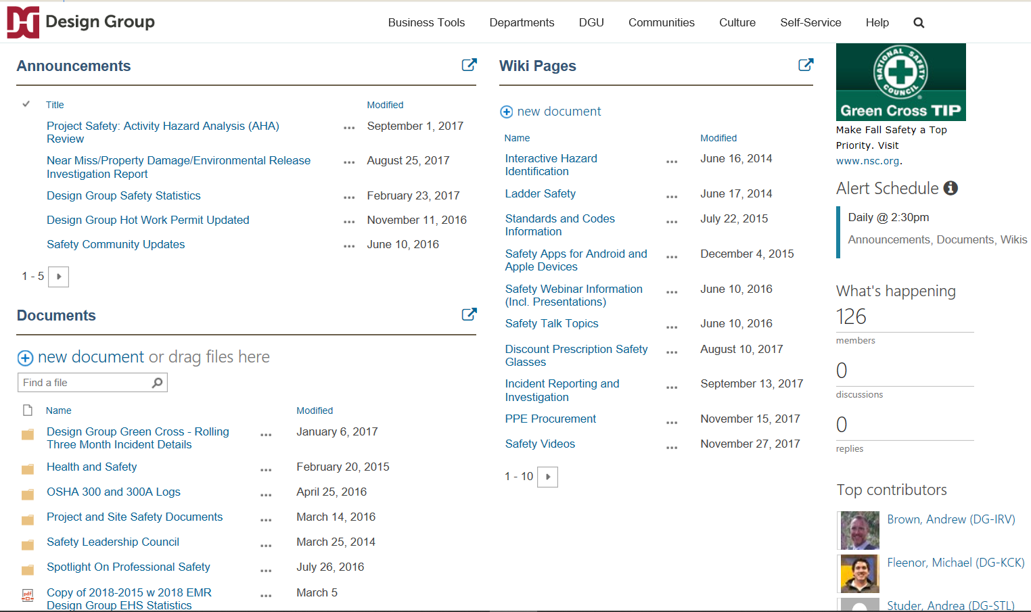
Providing Safety Resources to Empower

Slide 23
Pre-Mobilization Safety Considerations
Building a team:
Design Group Practice Professionals: Experience and education within project scope space – the backing of Practice support as needed.
Contractors/Vendors:
    Experience, education, references within project scope space.
    Pre-qualification (EMR, RIR, OSHA violations, etc.)
Client: Dedicated to safety and works with project teams regarding project safety.
Successful projects have safety trained or in-training professionals.
  Design Group – Professionals complete safety training per functional duty
  Contractors/Vendors – Employees are safety trained per their functional duty and follow company policies as well as project safety plan for project.
Notes:
Teams operating within their scope space with appropriate education, experience, and pre-qualification lessen risk associated with project execution.

Slide 24
Project Safety Plan (PSP)
Project Safety Plan Development and Expectations
  Define Site Safety Responsibilities of Team:
  Safety Inspection, Analysis, and Continuous Improvement
  Hazard Prevention and Control
  Training & permitting requirements
  Incident Reporting, Root Cause Analysis, and Implementation of Action Steps
Approved by Construction P.M., Director of Construction, & Safety Manager

Slide 25
Safety Responsibilities
Defined within the Project Safety Plan
Everyone is responsible for safety consistent with their role on the Project.
Stop Work Authority must be, at the very least, the one responsibility everyone shares.
  Empowered professionals will feel confident to use Stop Work Authority when they know that their leadership supports them
    Why culture matters!

Slide 26
Safety Inspection, Analysis, and Continuous Improvement
C.M./G.C. inspections to ensure safe work practices are being adhered to:
  Inspection may result in a discussion with the foreperson regarding safety of task.
  Will stop work if immediate danger to life and health is observed.
Contractor/Vendor/Supplier inspections to ensure team(s) are adhering to company and Project Safety Plan safe work expectations.
Client inspections to ensure safety work practice and GMPs (if any) expectations are being met.

Slide 27
Hazard Prevention and Control
Completion of a safety analysis where called for in PSP.
  Job/Activity/Task Hazard or Safety Analysis – however defined - are completed for the intent purpose of:
    Identifying task steps;
    Identifying hazards of steps;
    Identifying controls to be used to mitigate or eliminate hazards of steps/task.
  If there is a task that is unusual or identified as a higher risk activity task, a formal safety analysis among all stakeholders must be performed to identify how to safely proceed with task. Examples include:
    Critical Crane or other type Lifts
    Live Electrical Work
    Power up/Start up (Energization of equipment)
    Tasks that present a hazard to the public
    Etc.
Notes:
When should the JHA’s be performed? A: Generally, performed on a shift basis for activities/tasks regardless of risk.
Planning for Prevention

Slide 28
Training and Permitting Requirements
Project team members must be trained in the safety required for the task. Typically the Construction Manager at Risk presents site specific safety expectations and the contractor trains their employees on all safety related to their functional duty. Training can include:
  General Awareness;
  Targeted Training:
    Site safety expectations (Orientation);
    Fall Protection;
    Equipment Operations;
    LO/TO;
    Live Electrical
    Etc.

Slide 29
Training and Permitting Requirements
Safety Plan will identify certain permits required to be completed prior to performing task. Common permits include:
  General Work Permit (could be in lieu of or in addition to pre-task safety analysis)
  Hot Work (Flames/Sparks/Etc.)
  Roof Work
  Work at Heights
  Confined Space
  Live Electrical
  LO/TO

Slide 30
Incident Reporting, Root Cause Analysis, and Action Step Implementation
Addressing incidents (identified in the PSP) if they occur;
Determining the root cause;
Implementing action steps to help eliminate recurrence is critical to changing unsafe behavior and improving safe work practice expectations.

Slide 31
Lessons Learned
Internally review:
  Project safety metrics,
  What worked well?
  What didn’t work well?
  How can we improve for next project?
Externally:
  Engage client for their feedback
  Engage contractors and sub-contractors for feedback
Notes:
- Past contractor performance/compliance.

Slide 32
Thank you, SENY!
Questions?
Contact Info:
James Dickerson - Manager, Engineering
Design Group 411 Airport Executive Park Nanuet, NY 10954 Mobile +1 (201) 334-2227 www.bwdesigngroup.com

