Slide 1
Worker and jobsite safety is your priority and ours.
2019 SECNY United Academy Overview
Notes:
As the largest rental company in the world, United Rentals goal is to make our industry a safer place to work. One of the most impactful ways to do this is thru quality safety training. When we first set out to architect United Academy, we reached out to some of our customers to understand the challenges they had training their employees. This is what they said… you might recognize some, if not all, of these pain points.

Slide 2
Training Challenges
Safety training quality varies across the industry
Every jobsite has different requirements and labor skills
A lot of time, resources and cost goes into managing employee certifications and training requirements
The workforce is transient with new dynamics
Learner comprehension and learning preferences have evolved
Notes:
Today, the quality of safety training varies across our industry:
First is the skillset of the trainer. There is a wide range of teaching experience as well as industry experience of those leading safety training.
Second, some training courses offered do not satisfy regulatory requirements in one country let alone the US and Canada and
Third, the duration of training often varies. For example, you can find courses one to become a boom lift operator in an hour and those courses have no hands-on evaluation which is required to become a safe operator.
Every job site varies too. Some are out doors, some indoors, some on flat terrain and some on rough terrain. The equipment used on job sites also varies. Our customers need to ensure their workers are certified to use the equipment required to safely complete tasks on every jobsite.
A lot of time is spent by our customers tracking training and certifications. In fact, this is the number one concern we hear from our customers regarding safety training. Many track their employee training using Excel or other manual processes. These records are not only difficult to keep current but also to use when trying to plan future training needs.
Our workforce is transient especially so over the last few years when companies were laying off workers. Workers will migrate to where the work is and need to take their training with them.
Learner preferences have evolved. One example of this is that our younger workforce often likes to learn online by themselves, while others like to learn in a classroom setting to share experiences and ask questions. In additional, there are many more Spanish speaking workers in our industry today.

Slide 3
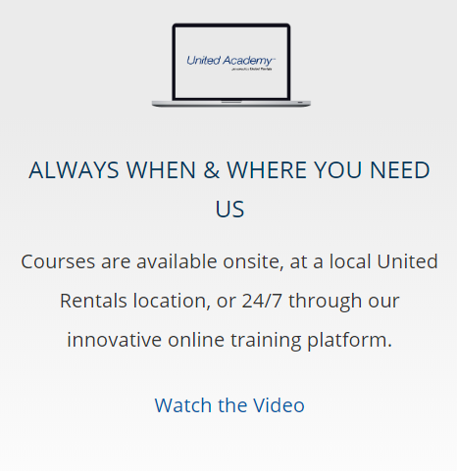
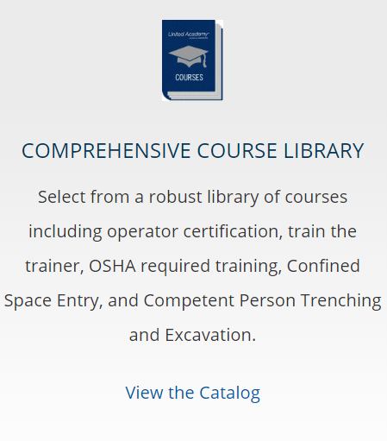
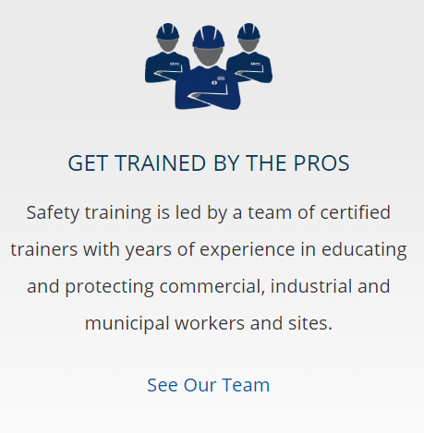
United Academy
Over 400 Courses
Available Anywhere
Instructor Lead
Notes:
Courses Include:
Equipment Training (Aerials, Forklifts, Dirt)
Fall Protection
OSHA
Confined Space
Trench
Available 24/7
Can be taken anytime anywhere
Equipment Evaluations conducted by Certified Evaluators across the country
Available in English, Spanish, French
Dedicated Training Team:
Over 75 instructors Nationwide for Classroom Training

Slide 4
Blended Learning
Alternative to traditional classroom
Flexibility, taken anytime at students pace
Online interactive game-like learning modules
More interesting to younger workers
Evaluations conducted nationwide at participating locations
Notes:
Different people like to learn differently. Millennial's, as an example, have shown that they like to learn online rather than in a classroom. Others like to attend classroom sessions for the comradery and ability to ask questions and share experiences. At United Academy we offer our core courses in multiple formats to appeal to a broad array of learners.
Note: Blended Learning courses offered include:
Boom lift operator certification
Scissor lift operator certification
AWP Operator Certification
AWP Operator Recertification
Rough terrain forklift operator certification
Counter balance forklift operator certification
Counter balance and rough terrain forklift operator certification
Forklift Combo Recertification
Skid steer/front end loader Combo
Excavator/ backhoe Combo
Fall Protection USA
Fall Protection Canada (coming Q2 2017)

Slide 5
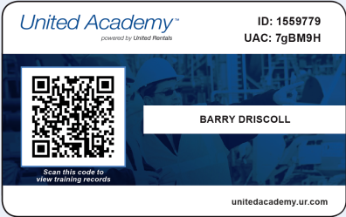
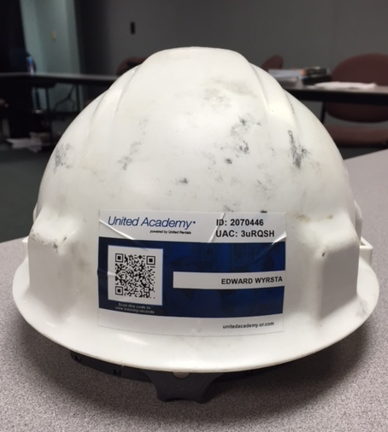
Introducing the Universal Wallet Card
Scan the wallet card above to see a Training Profile
With the United Academy wallet card and mobile app, accessing your Training Profile is easy. Just scan the QR code on the card with a compatible mobile device for instant access.
Notes:
With the United Academy universal wallet card and free United Academy App, customers can access their Training Profile anywhere and anytime with a computer or mobile device. All you have to do is key in the personal identification codes into a computer or scan the QR code on the card with a smartphone or tablet for instant access. Try scanning the wallet card shown here.
Our wallet card is secure and credit card quality so it won’t tear or become damaged by the elements.
Wallet cards are sent to United Academy account holders after completing their first Academy course and it takes approximately 2 weeks to receive it at the address they used to enroll into the Academy.
The United Academy wallet card and comprehensive training profile makes United Rentals’ safety training program stand out from our competition…employers have online access to course results to satisfy documentation of training requirements… and Operators receive proof of completion certificates to demonstrate qualifications to employers and jobsite managers.

Slide 6
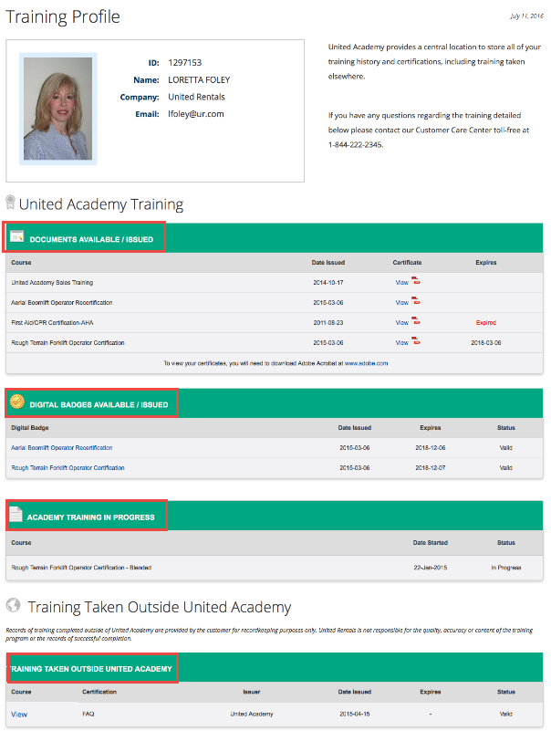
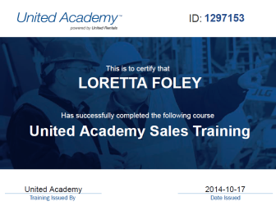
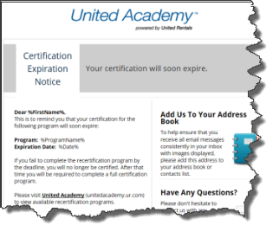
Training Profile
Notes:
Customers can save time and money by storing and maintaining training and certifications in United Academy. Records for each course taken thru the Academy are stored in our online database and a training profile, as shown here, is created for every account holder.
Users can also store additional records for training taken outside of United Academy so that they can build a comprehensive training transcript allowing United Academy to be the go to place for training and certification tracking in our industry.
Using the red icons on the Training Transcript one can view the course Certificate of Completion and a temporary wallet card.
Notifications are sent on an automated basis from the Academy to alert customers of upcoming certification expirations and other important information so that they can manage training for themselves, or their employees, on a proactive basis so lapses in certifications won’t happen. We even track certification expirations for training taken outside of the Academy!

Slide 7
Getting started is easy
Membership is Free
View our course catalog at UnitedAcademy.ur.com
Create a Corporate Account to purchase training and register employees for classes
Credits can be purchased online via Credit Card
PO or Check payments can be made by calling our customer care team at 1-888-222-2345
Notes:
So, how do you get started?
First, we invite you to log into United Academy to view our course catalog using the website address shown.
Second, set up a United Academy Corporate Account which is required to purchase classes. All that is needed is some basic information about you and your company.
Third, we have made purchasing training easy. You can either use our online shopping cart system to purchase courses with a credit card OR if they want to use a PO or check, they simply need to call our Customer Care Center and a dedicated United Academy agent will be happy to place their order for them (in RentalMan).

Slide 8
Looking Ahead: Simulators

