Slide 1
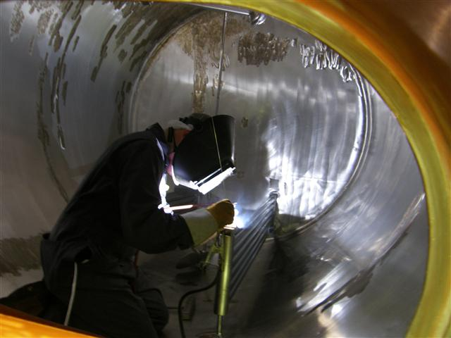
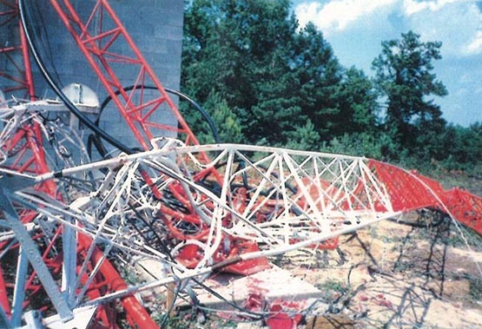
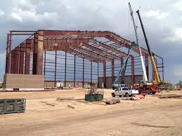
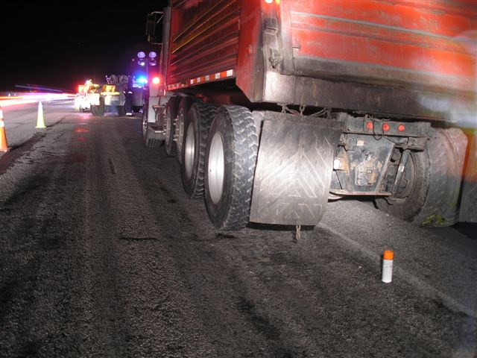
OSHA UPDATE Safety Executives of New York PDC March 20, 2018
Warren G Simpson, MS, CIH, CSP
ARA for Enforcement Programs, Region 2
Occupational Safety and Health Administration
simpson.warren@dol.gov
Notes:
1

Slide 2
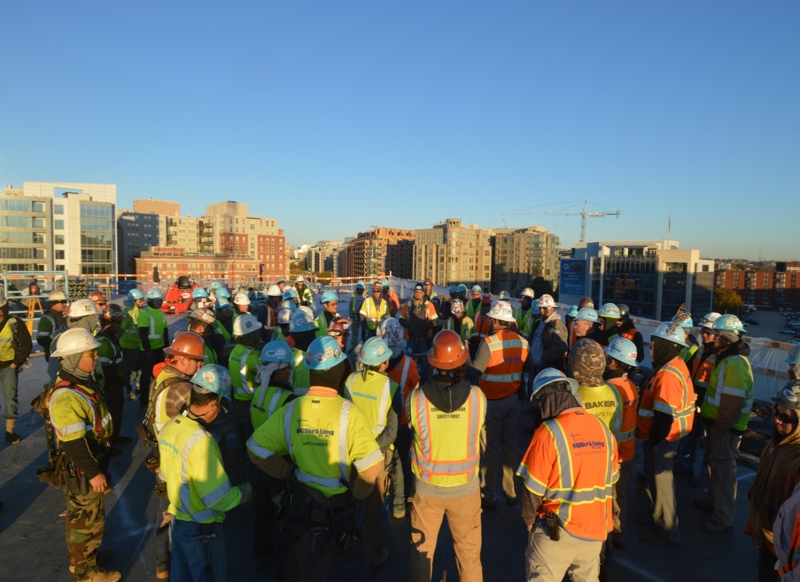
Agenda
Statistics
Enforcement
Regulatory Update
Safe & Sound Campaign
Fall Stand Down Campaign

Slide 3
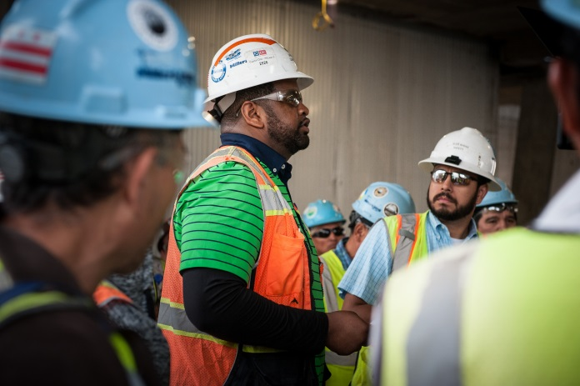
The Construction Industry
90% of Construction Employers have 20 or less employees.
The industry typically has very high turnover rates.
Most are multi-employer worksites.
Over half of OSHA compliance inspections are construction (three year average, FY15-17).

Slide 4
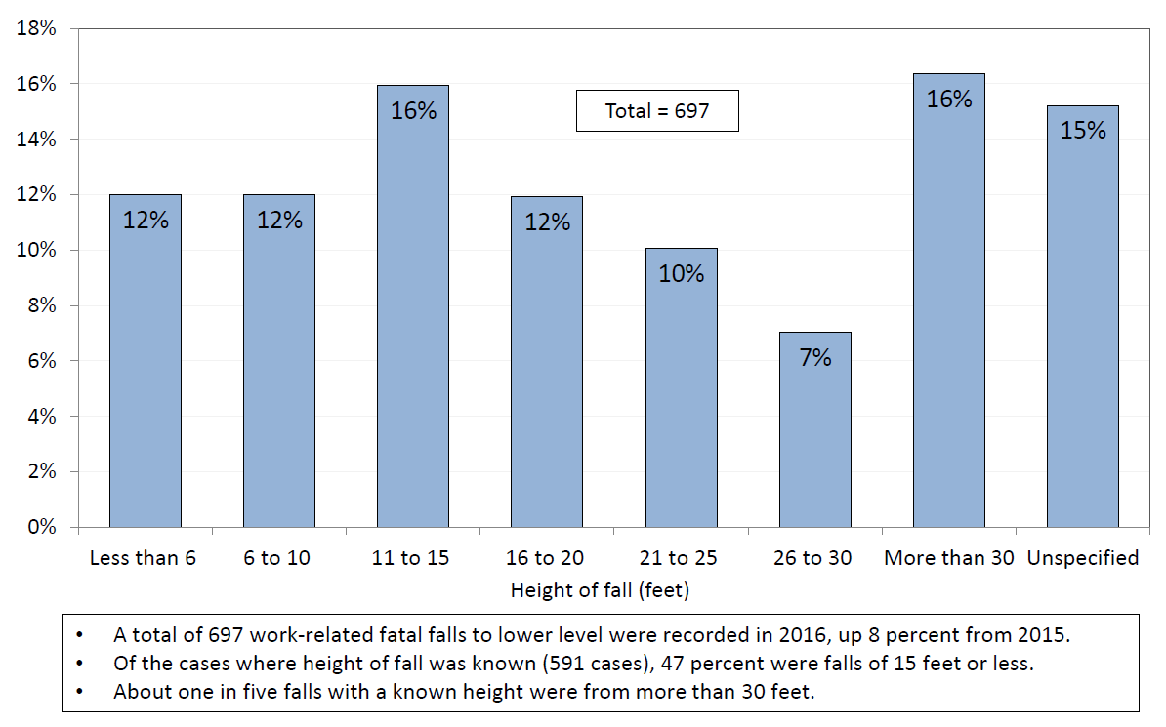
Fatal falls to lower level by height of fall, 2016

Slide 5
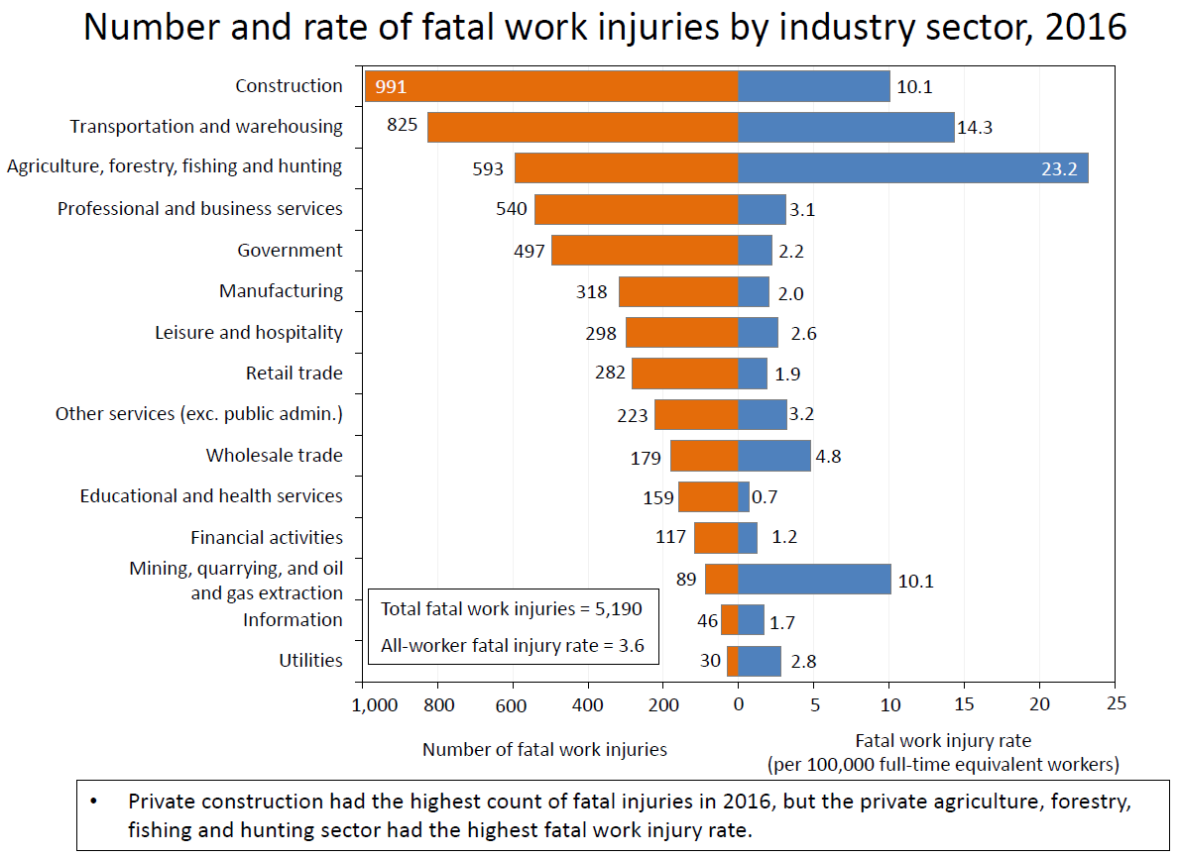

Slide 7
Trenching Injuries & Deaths
Characteristic | All events⁽¹⁾ | Ex. / trench cave-in (code 651XXX)
 | 2016 | 2011 | 2012 | 2013 | 2014 | 2015 | 2016
Location:
Private residence | 597 | 6 | 5 | 5 | 6 | 5 | 15
Industrial place and premises | 1061 | 7 | 5 | 9 | – | 15 | 8
Street and highway | 1684 | – | 1 | 7 | 4 | 5 | 10

Slide 8
Construction Industry Fatalities
Years | 2010 | 2011 | 2012 | 2013 | 2014 | 2015 | 2016
Total Fatalities All Construction | 774 | 738 | 806 | 828 | 899 | 937 | 991
Fatality Rates All Construction | 9.8 | 9.1 | 9.9 | 9.7 | 9.8 | 10.1 | 10.1
Source of fatality data: Bureau of Labor Statistics

Slide 9
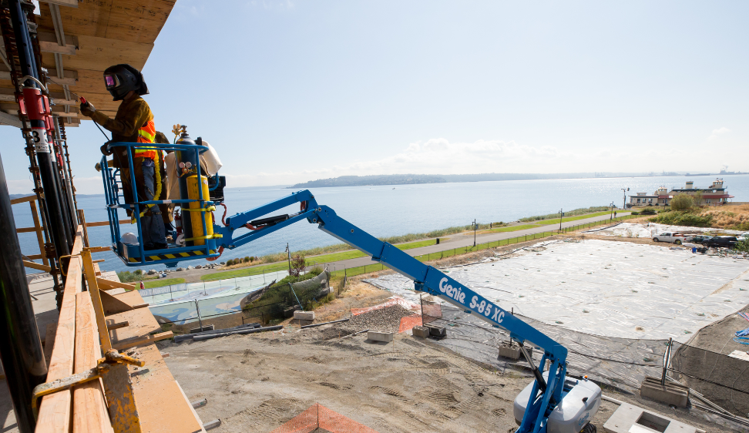
OSHA Top 10 Most Cited Violations
1. Fall Protection
2. Hazard Communication
3. Scaffolding
4. Lockout/Tagout
5. Respiratory Protection
6. Ladders
7. Machine Guarding
8. Powered Industrial Truck
9. Electrical –Wiring.
10.Fall Protection Training
Note: All Industries
as of Sept. 30, 2017

Slide 10
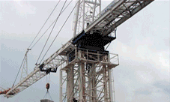
Crane Operator Qualification
Crane Operator Requirements Extension
Maintains Current Crane Operator Competency Requirements
Extends the Effective Date of Crane Certification Requirements to November 10, 2018
Crane Operator Competency (NPRM)
Maintains Employer Obligation to Ensure Crane Operator Competency
Provides Crane Operator Competency Evaluation Criteria
Clarifies Crane Operator Training Requirements
Revises Certification Requirements (not by capacity)

Slide 11
Regulatory Activities
Deregulatory/Correction Rules
Standards Improvement Project IV (Final Rule) – 19 affected rules
The purpose of this SIP-IV rulemaking is to remove or revise outdated, duplicative, unnecessary, and inconsistent requirements in OSHA’s safety and health standards.
The Agency believes that improving OSHA standards will increase employers’ understanding of their obligations, which will lead to increased compliance, improve employee safety and health, and reduce compliance costs.
SIP rulemakings do not address new significant risks or estimate benefits and economic impacts of reducing such risks.
Overall, SIP rulemakings are reasonably necessary under the OSH Act because they provide cost savings, or eliminate unnecessary requirements.

Slide 12
Regulatory Activities
SIP(IV) examples:
Removes requirements for social security numbers on 17 health standard record requirements
Permits storage of x-rays in digital formats. OSHA adopted the existing requirement for storage of x-ray film before the existence of digital x-ray and storage technology.
Updates the lung-function testing (spirometry) requirements for the cotton dust standard to make them consistent with current medical practices and technology.
Existing requirements in the sanitation standard for Shipyard Employment specify that employers must maintain workplaces in a manner that prevents vermin infestation. OSHA proposes to remove the term "feral cats" from the definition of vermin in the standard.
Exempts single family dwellings from a requirement to post maximum safe-load limits for floors in buildings under construction, reducing a burden for residential builders.

Slide 13
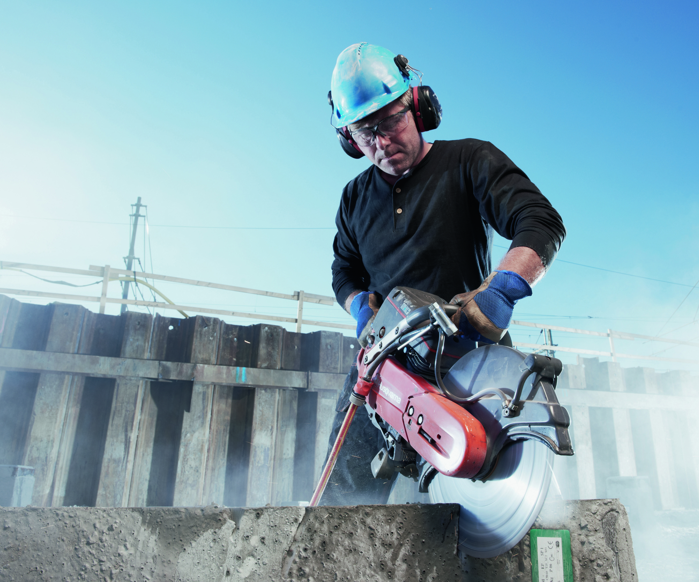
Respirable Crystalline Silica:
The Construction Standard

Slide 14
Crystalline Silica in Construction
Publish Date: March 25, 2016
Effective Date: September 23, 2017
The standard establishes a new 8-hour time-weighted average (TWA) Permissible Exposure Limit (PEL) of 50 µg/m³, an action level (AL) of 25 µg/m³, and a host of ancillary requirements.

Slide 15
Construction – Specified Exposure Control Methods
Table 1 in the construction standard matches 18 tasks with effective dust control methods and, in some cases, respirator requirements.
Employers that fully and properly implement controls on Table 1 do not have to:
Comply with the PEL
Conduct exposure assessments for employees engaged in those tasks

Slide 16
Example of a Table 1 Entry
Equipment / Task | Engineering and Work Practice Control Methods | Required Respiratory Protection and Minimum APF
 |  | ≤ 4 hr/shift | > 4 hr/shift
Stationary masonry saws | Use saw equipped with integrated water delivery system that continuously feeds water to the blade. Operate and maintain tool in accordance with manufacturer’s instructions to minimize dust emissions. | None | None

Slide 17
Example of a Table 1 Entry
Equipment / Task | Engineering and Work Practice Control Methods | Required Respiratory Protection and Minimum APF
 |  | ≤ 4 hr/shift | > 4 hr/shift
Handheld power saws (any blade diameter) | Use saw equipped with integrated water delivery system that continuously feeds water to the blade. Operate and maintain tool in accordance with manufacturers’ instruction to minimize dust When used outdoors When used indoors or in an enclosed area | None APF 10 | APF 10 APF 10

Slide 18
Guidance and Outreach
Silica Rulemaking Webpage: www.osha.gov/silica
Fact sheets
FAQs
Video
Small Entity Compliance Guide
Appendix B – Medical Surveillance Guidelines

Slide 19
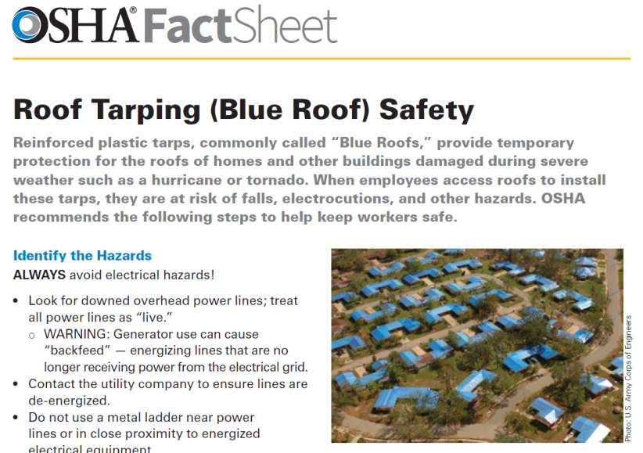
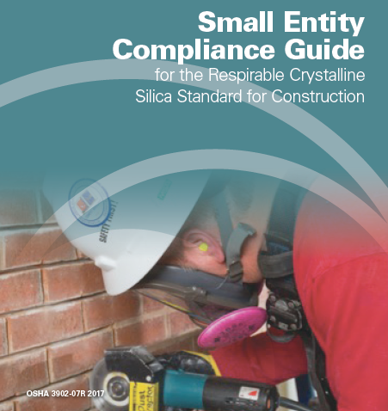
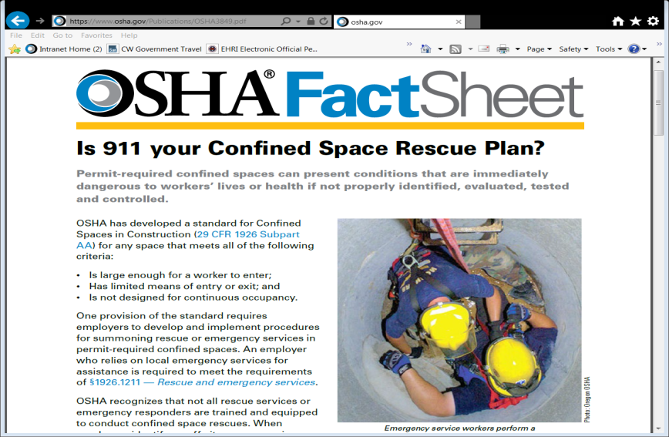
Construction Guidance
DOC FS—3926 11/2017
OSHA 3902-07R 2017
DOC FS-3849 04/2016

Slide 20
Mono rail Hoist Enforcement Policy
The purpose of this memorandum is to announce a temporary enforcement policy pending the resolution of that rulemaking process.
OSHA Memorandum Effective June 30, 2017.
For Construction Application monorail hoist is covered by 29 CFR 1926. 554 and other applicable provisions such as Subpart O
For General Industry Applications monorail hoists are covered by Section 5 (a)(1) the general duty

Slide 21
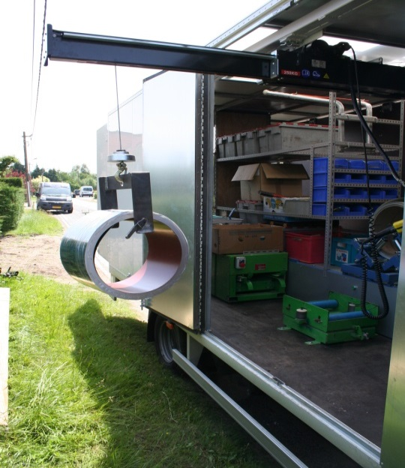
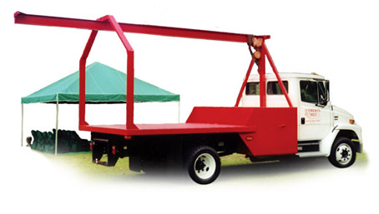
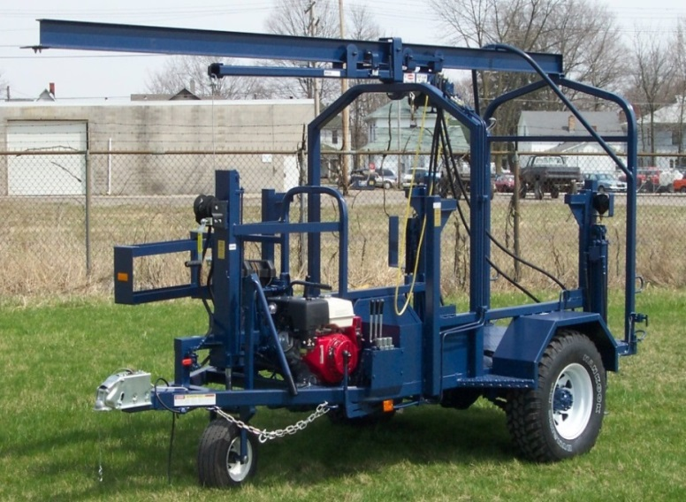
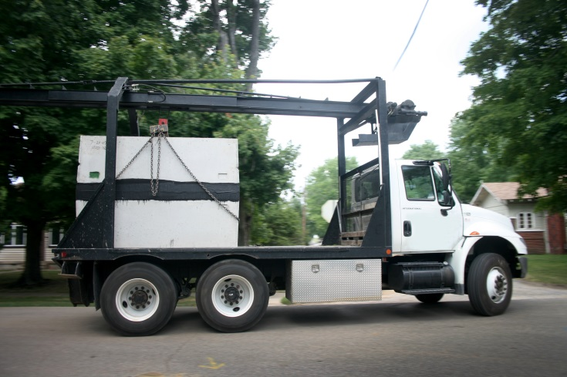
Examples of Monorail Hoists
Work Vehicle Mounted Monorail Hoist
Burial Vault Delivery Rig
Mast Climber with Non-Swinging Mounted Monorail Hoist
Vault Handler
Septic Tank Delivery Rig

Slide 22
Subpart D - Walking Working Surfaces and Fall Protection Standards - GI
Allows choice of non conventional fall protection
Updates scaffold requirements
Adds training requirements
Became effective 1/17/2017

Slide 23
Employee Involvement 1904.35
Effective 12/01/2016
The employer must have a reasonable procedure in place for employees to report injuries and illnesses without retaliation.

Slide 24
Electronic Reporting of Injury and Illnesses -1904.41
Effective date 1/1/2017, submittal of 2016 data extended to 12/15/2017, 2017 data 7/1/2018.
Companies over 250 employees must submit data 300, 300A, and 301reports
Companies over 20 but less 250 but only specific industries. (appendix A) 300A only

Slide 25
Beryllium Standard
Effective 5/20/2017
PEL was lowered from 2ug/m3 to .2ug/m3
Ancillary requirements
Enforcement has been delayed until 5/11/2018

Slide 26
Safe + Sound Week 2018
National Event to be held August 13-19, 2018
Goal: Raise awareness and understanding of the value of safety and health programs among workplaces, as well as encourage their voluntary adoption and implementation.
Participants commit to taking proactive safety and health program actions for the core elements of management leadership, worker participation, and finding and fixing hazards
Pre-registration and new resources for Safe + Sound Week 2018 estimated to go live in April
www.osha.gov/safeandsoundweek

Slide 27
2018 National Fall Safety Stand-Downs to be held May 7-11, 2018

Slide 28
2018 National Safety Stand-Down
To recognize the often fatal hazard of falls, tens of thousands of employers and more than a million workers across the country joined OSHA in 2017 for week long Fall Safety Stand-Down, the largest occupational safety event ever held.
The Safety Stand-Down is part of OSHA’s ongoing fall prevention campaign to raise awareness of fall hazards in construction.
More than 2 million workers reached = 1,041,307 from certificates (plus 1.5 million from the Air Force)
Number of unique entries/stand-downs = 4,669
Number of companies that held stand-down events on more than one day = 2839

Slide 29
Resources
OSHA Construction page: http://www.osha.gov/doc/index.html
National Safety Stand-Down page: http://www.osha.gov/StopFallsStandDown/index.html
OSHA Rulemaking page: https://www.osha.gov/OSHA_FlowChart.pdf

Slide 30
Questions?

